Slide 1
Introduction to Regularization

Slide 2
Regularization (1)
Regularization is the process of introducing additional information in order to solve problems more easily and/or
to reduce overfitting.
Regularization can enhance the prediction accuracy and/or interpretability of the model it produces.
Regularization often encourages (or requires) models to be simpler rather than more complex.

Slide 3
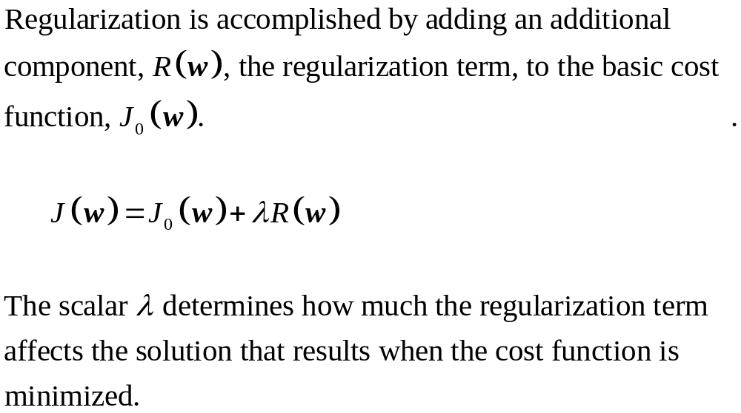
Regularization (2)

Slide 4
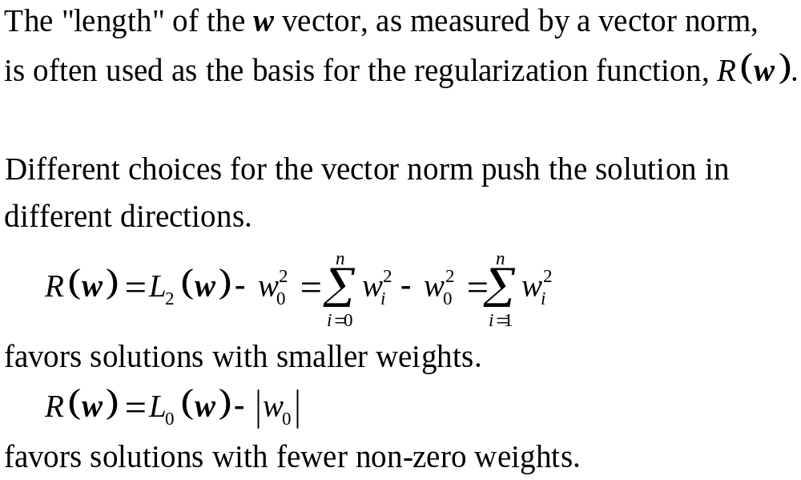
Regularization (3)

Slide 5
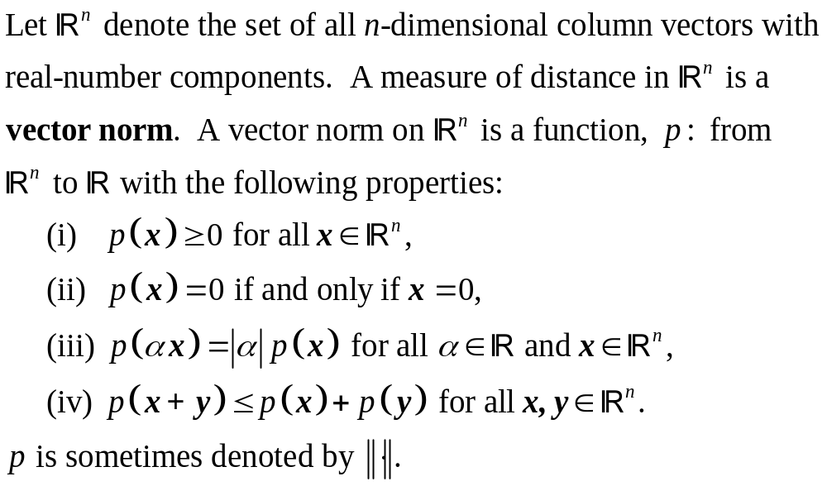
Vector norms

Slide 6
Various vector norms
L^{P} Norm (Minkowski norm)
L² Norm (Euclidean norm)
L¹ Norm (Taxicab norm, Manhattan norm)
L⁰ Norm
L∞ Norm (Maximum norm, sup norm)

Slide 7
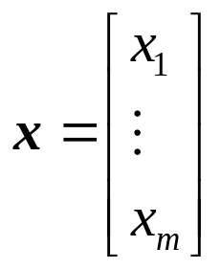
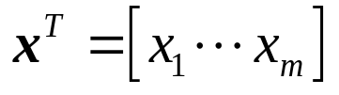
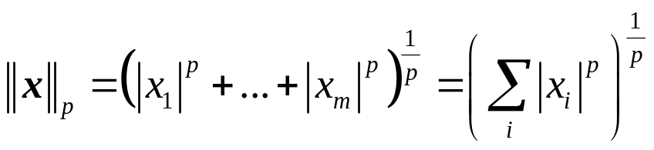
L^{P} norm or Minkowski norm (1)

Slide 8
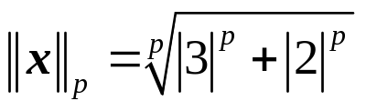
L^{P} norm or Minkowski norm (2)
2
3

Slide 9
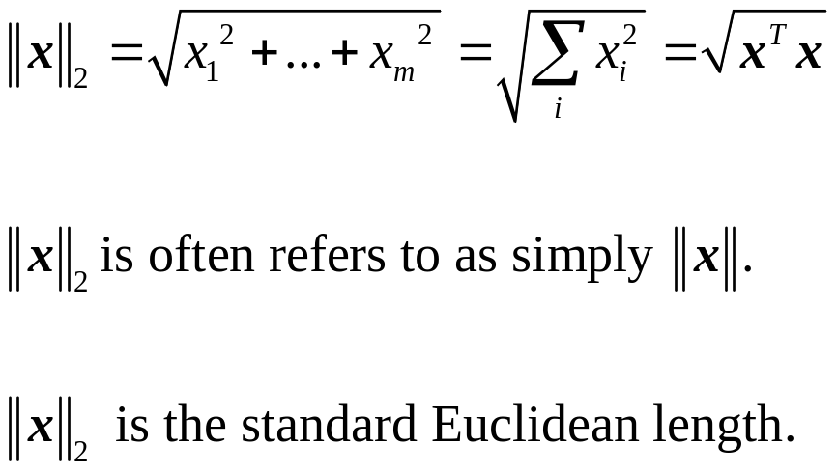
L² norm (Euclidean norm) (1)

Slide 10
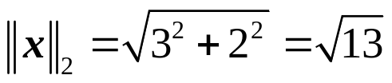
L² norm (Euclidean norm) (2)
2
3

Slide 11
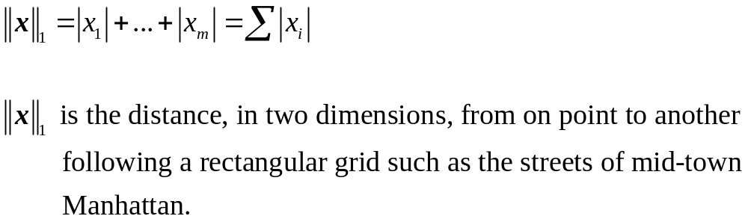
L¹ norm (Taxicab norm, Manhattan norm) (1)

Slide 12

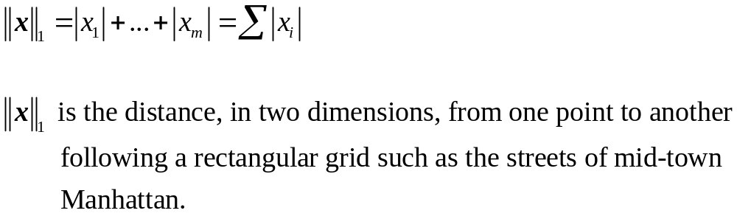
L¹ norm (Taxicab norm, Manhattan norm) (2)
2
3

Slide 13
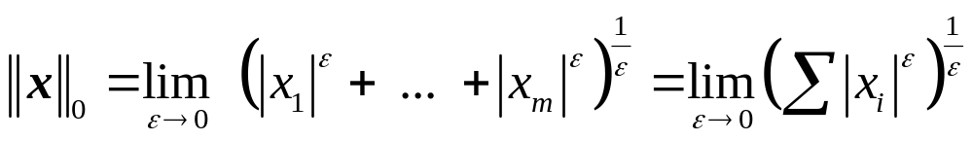
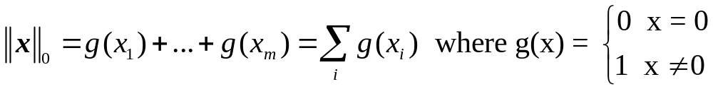
L⁰ norm (1)

Slide 14


L⁰ norm (2)
2
3

Slide 15
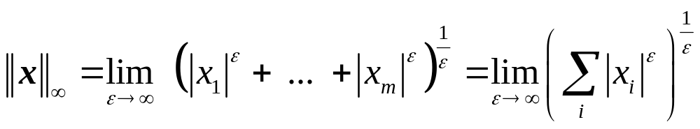

L∞ norm (Maximum norm, sup norm) (1)

Slide 16
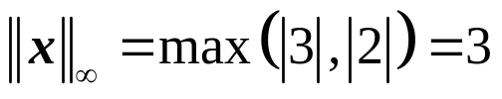
L∞ norm (Maximum norm, sup norm) (2)
2
3

Slide 17
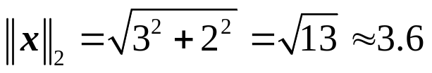
Norm examples
2
3

Slide 18
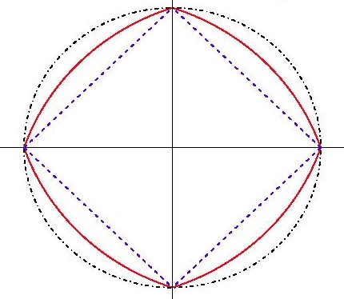
L₁₂ regularization (aka Elastic Net)
L₂
L₁
λ₁L₁ + λ₂L₂
In this example, λ₁=λ₂= 1/2

Slide 19
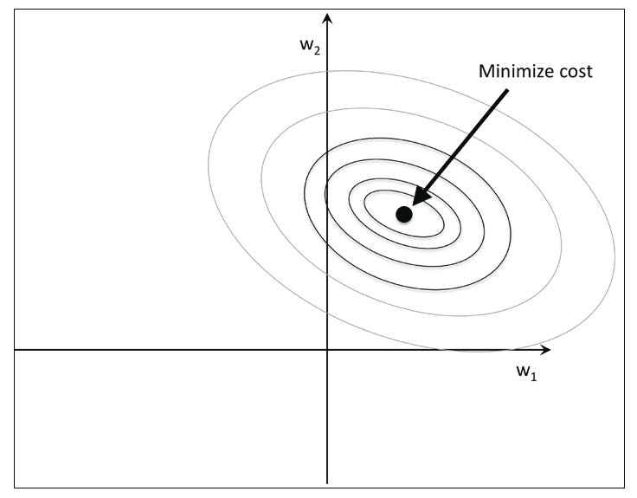
Cost function without regularization
from Raschka and Mirjalili

Slide 20
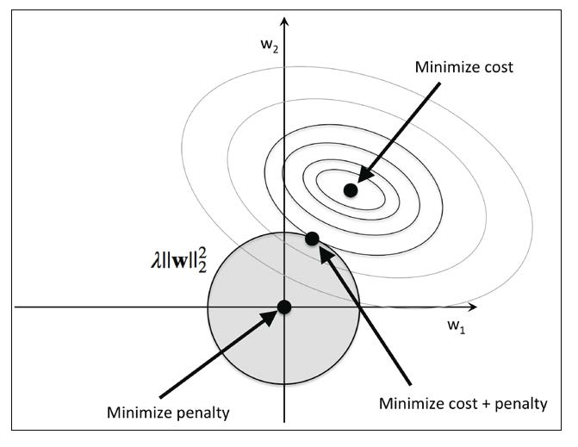
Cost function with L2 regularization
from Raschka and Mirjalili

Slide 21
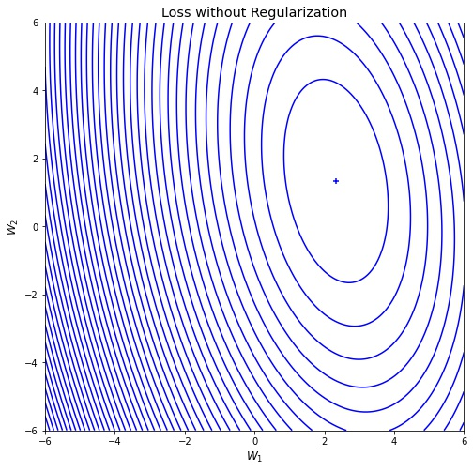
Plot of loss without regularization (1)

Slide 22
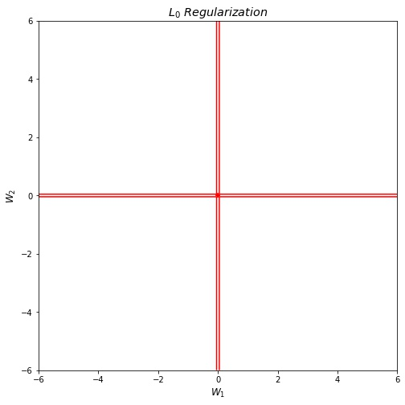
Plot of L0 regularization

Slide 23
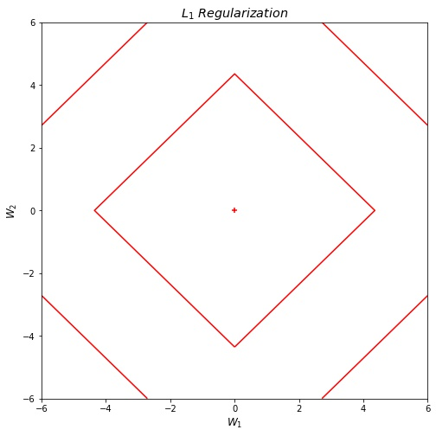
Plot of L1 regularization

Slide 24
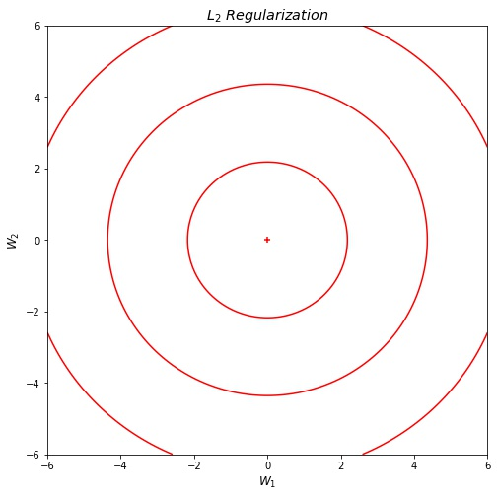
Plot of L2 regularization

Slide 25
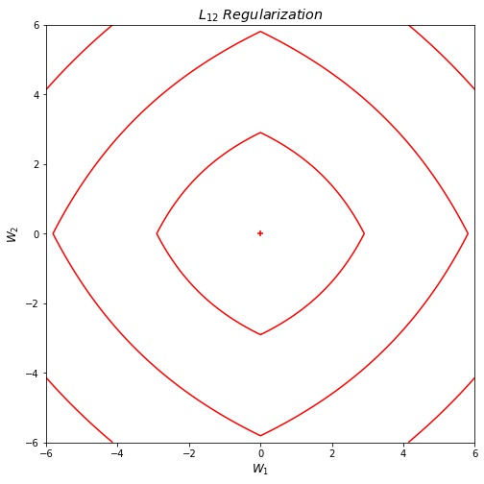
Plot of L12 regularization

Slide 26
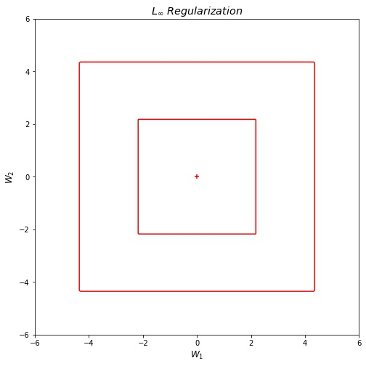
Plot of Lꝏ regularization

Slide 27
Plot of loss without regularization (2)

Slide 28
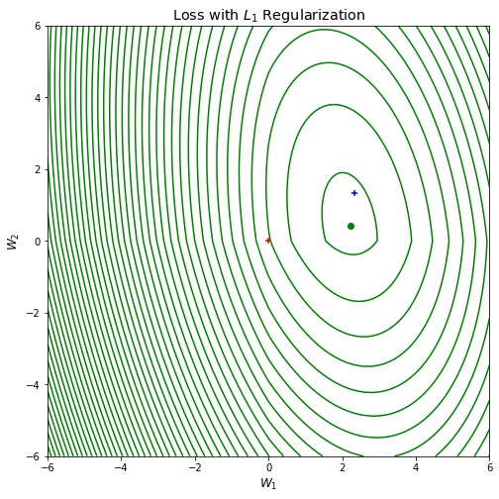
Plot of loss with L1 regularization

Slide 29
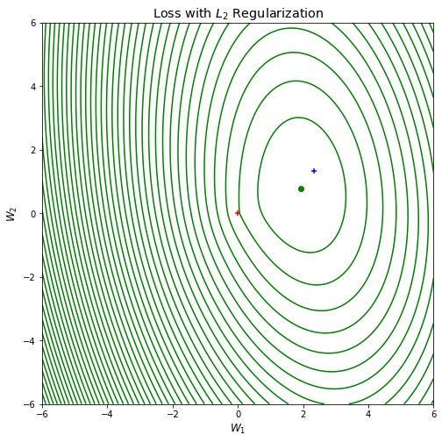
Plot of loss with L2 regularization

Slide 30
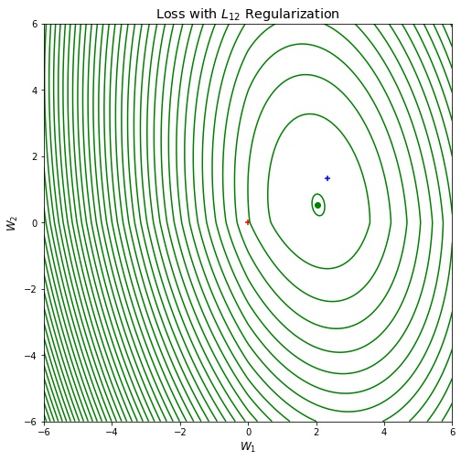
Plot of loss with L12 regularization

Slide 31
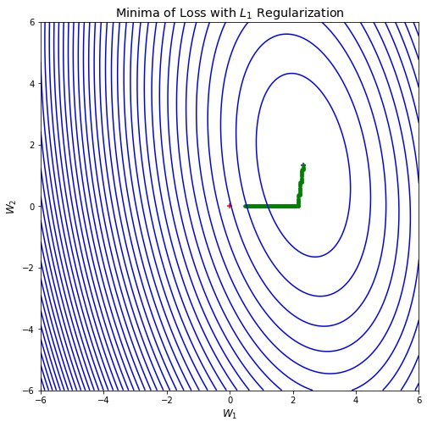
Plot of minima of loss with L1 regularization

Slide 32
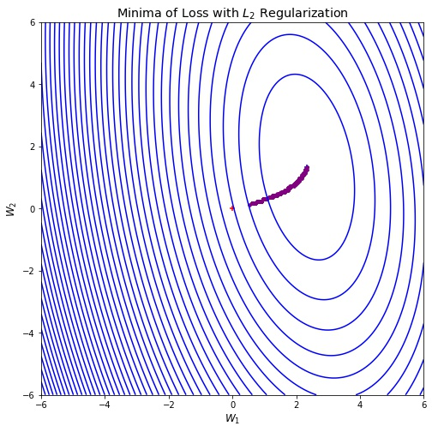
Plot of minima of loss with L2 regularization

Slide 33
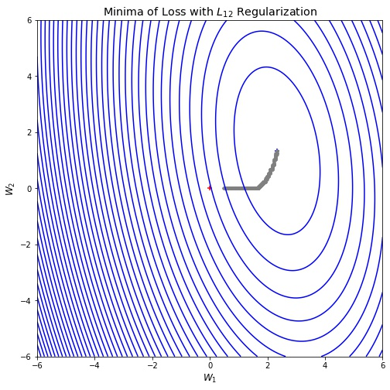
Plot of minima of loss with L12 regularization

Slide 34
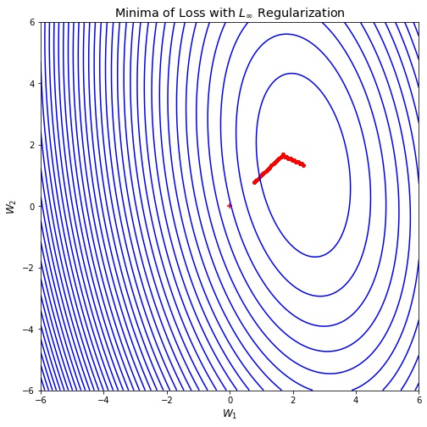
Plot of minima of loss with Lꝏ regularization

Slide 35
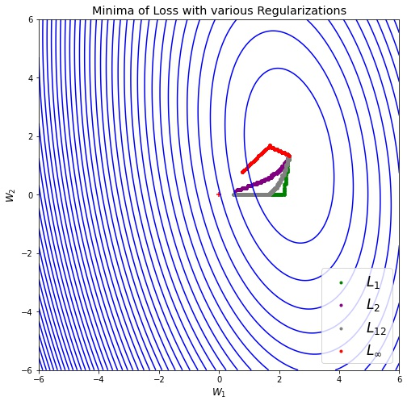
Plot of minima of loss with various regularizations (1)

Slide 36
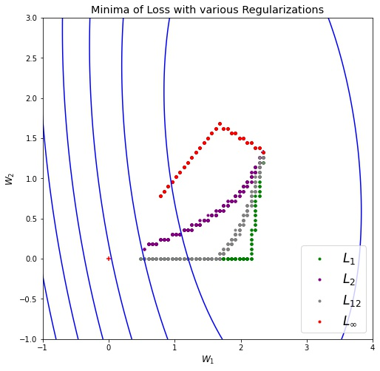
Plot of minima of loss with various regularizations (2)

